Slide 1

IOT BASED SMART ARICULTURE MONITORING SYSTEM
Under the Guidance of:
Prof. NEEBA SABU
Presented By:
ANUSHA K K - KTE17EE018
HARIDEV V S - KTE18EE031
HEERA N - KTE18EE034
SANU STEEPHEN - KTE18EE050
Department of Electrical and Electronics Engineering Rajiv Gandhi Institute of Technology
Kottayam-686501 October 2022

Slide 2
PROBLEM STATEMENT
Traditional irrigation requires excessive amounts of water and consumes high electrical energy to schedule irrigations.
Nearly 60% of water used for irrigation is wasted.
Labour charges and time is expended for frequent visits and monitoring of farm area.
Unfavourable environment conditions can severely affect the crop growth and yield.

Slide 3
INTRODUCTION
Agriculture is undoubtedly the largest livelihood source.
Automation in agriculture will increases the productivity and decreases physical work.
IoT Technology can help in collecting information about conditions like soil moisture, weather, temperature etc.
Integration of embedded technology and IoT in agriculture field can provide an efficient way to monitor and control various parameters.

Slide 4
Wireless sensor networks can be used for monitoring the farm conditions and micro controllers can be used to control and automate the farm processes.
Smart Agriculture Robotic system is a method to make the procedure of farming more precise and accurate
The main focus is to reduce the human effort and resources which can enhance the yield.

Slide 5
LITERATURE
REVIEW

Slide 6
SMART FARMING
Smart farming is the advancement of precision farming. The focus of precision farming was mainly on technological invention to allow for site-specific farming.
Smart farm is about empowering today's farmers with the decision tools and automation measurement technologies that integrate products, knowledge and services for better productivity, quality and profit.
The most important things of smart farming are environmental measurements and water management. The reason is that the environmental and water management affects plant growth.
In addition, environmental measurements using wireless sensor network and water management technology are much simpler, cheaper and lower running costs.

Slide 7
INTERNET OF THINGS
The Internet of Things (IoT) is one of the emerging technologies that promise to transform the way on how people work and live.
The term IoT refers to a network of physical objects ‘‘things’’ that contain embedded systems with connectivity and computing power to exchange data with other devices and systems over the Internet.
IoT has become an ideal choice for smart agriculture due to its highly scalable and ubiquitous architecture.
Smart agriculture has started incorporating IoT solutions to improve operational efficiency, maximize yield, and minimize wastage through real-time field data collection, data analysis, and deployment of control mechanisms.

Slide 8
INTERNET OF THINGS(…)
Also, the diverse of IoT-based applications such as precision farming and smart irrigation is very helpful to the enhancement of agricultural processes.
Thus, the IoT is considered as one of the promising solutions for embracing connected farms to address agriculture-based issues and increase the quality and quantity of agricultural production.

Slide 9
WIRELESS SENSOR NETWORK
Collects data through wireless channels and reports over the Internet.
Networks of spatially dispersed and dedicated sensors that monitor and record the physical conditions of the environment and forward the collected data to a central location.
WSNs can measure environmental conditions such as temperature, sound, pollution levels, humidity and wind.

Slide 10
OBJECTIVES
To design and implement a robotic car for agriculture field monitoring
Incorporation of automatic irrigation and exhaust control system for maintaining optimum conditions for crops.
To provide live streaming of farm area for timely monitoring.
To minimize the use of water and electrical energy required for farm processes

Slide 11
FEATURES
Provides area wise monitoring of farms using IoT.
Provides manual and automatic control of water pump and irrigation system.
Collects data regarding the soil moisture, sunlight intensity, temperature and humidity.
Robotic arm for collecting data from soil.
Onboard camera for live monitoring of farm area.
Uses path planning to reach the destination automatically.

Slide 12
PROPOSED SYSTEM
A Smart Agriculture Robotic System is developed through the application of advanced technologies including sensors, automation through robotics and IoT with cloud computing.
Different sub systems are integrated within a system.
The proposed system integrates all the functions such as irrigation, exhaust control and area wise monitoring of field into a single IoT robot and perform the operation automatically
IoT based smart robotic system is a complete solution for smart agriculture.

Slide 13
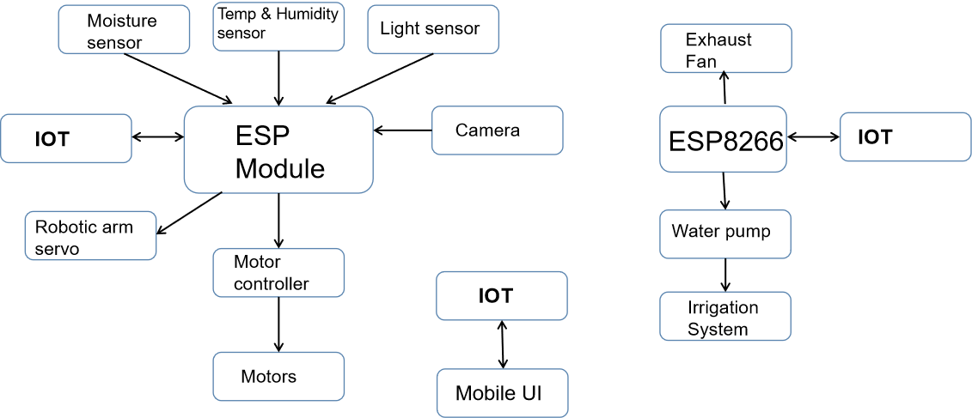
BLOCK DIAGRAM OF THE PROPOSED SYSTEM

Slide 14
COMPONENTS REQUIRED
ESP32 Microcontroller
Sensors - BH1750, DHT22, XH-M214
L298N Motor driver
DC motors
Servo motors
ESP32 cam
ESP8266

Slide 15
COMPONENTS(…)
ESP 32
ESP32 is a series of low-cost, low-power system on a chip microcontrollers with integrated Wi-Fi and dual-mode Bluetooth.
This module has a powerful enough on-board processing and storage capability that allows it to be integrated with the sensors and other application specific devices.
Specifications:
Operating voltage: 2.2V ~ 3.6V, Transfer rate: upto 150 Mbps,
Flash size: 4 MByte, Dimensions: 25 x 15 x 11 mm.

Slide 16
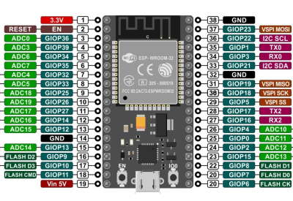
COMPONENTS(…)
Pin out diagram of ESP32

Slide 17
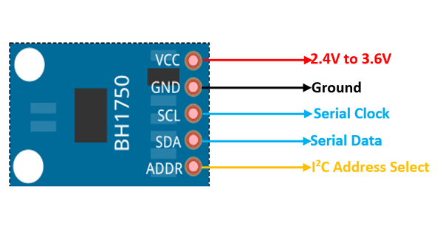
COMPONENTS(…)
Light Sensor- BH1750
BH1750 is a digital ambient light sensor that is commonly used in mobile phones to manipulate the screen brightness based on the environment lighting.
This sensor can accurately measure the LUX value of light up to 65535 lux.
Specifications
Power Supply: 2.4V-3.6V
Light range 0-65535 lux
built-in : 16 bit A/D converter
BH1750 Light Sensor Pinout

Slide 18
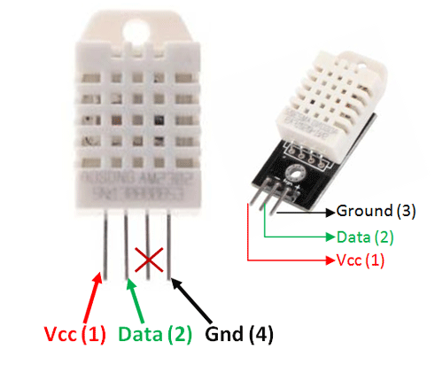
COMPONENTS(…)
Temperature and humidity sensor-DHT22
The DHT22 is a basic digital temperature and humidity sensor.
It uses a capacitive humidity sensor and a thermistor to measure the surrounding air, and gives out a digital signal on the data pin, no analog input pins needed
Specifications:
Operating Voltage: 3.5V to 5.5V
Temperature Range: -40°C to 80°C
Humidity Range: 0% to 100%
DHT22 Sensor Pinout

Slide 19
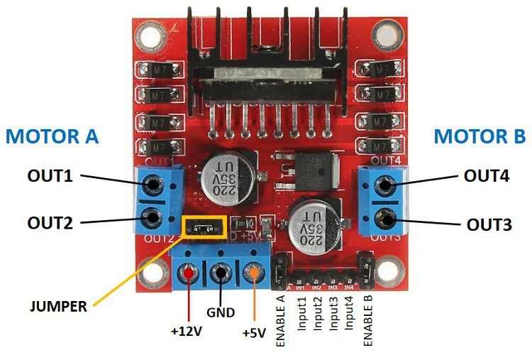
COMPONENTS(…)
L298N Motor Driver
This L298N Motor Driver Module is a high power motor driver module for driving DC and Stepper Motors.
This module consists of an L298 motor driver IC and a 78M05 5V regulator.
L298N Module can control up to 4 DC motors, or 2 DC motors with directional and speed control.
Specifications:
Driver Voltage: 5-35V
Driver Current:2A(max)
Max Power: 25W
L298N Motor Driver Module Pinout

Slide 20
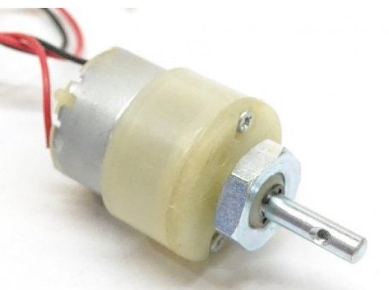
COMPONENTS(…)
DC geared motor
A gear motor is an all-in-one combination of a motor and gearbox.
The addition of a gear head to a motor reduces the speed while increasing the torque output.
Using the correct combination of gears in a gear motor, its speed can be reduced to any desirable figure.
Specifications:
Voltage: 12V
Speed : 300rpm
Torque : 2kg/Cm
DC geared motor

Slide 21
COMPONENTS(…)
Servo motor
A servo motor is a rotary actuator that allows for precise control of angular position.
It consists of a motor coupled to a sensor for position feedback. It also requires a servo drive to complete the system.
The drive uses the feedback sensor to precisely control the rotary position of the motor.
Two servo motors are used, i)SG-90 for ESP32 cam control
ii) MG995 for robotic arm control

Slide 22
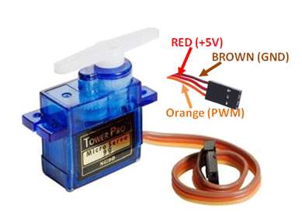
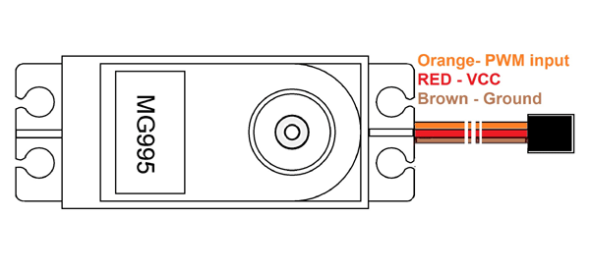
COMPONENTS(…)
Specification:
SG-90 servomotor
Operating Voltage is +5V typically
Torque: 2.5kg/cm
Operating speed is 0.1s/60°
Rotation : 0°-180°
MG995 servo motor
Operating voltage range: 4.8 V to 7.2 V
Rotational degree: 180º
Stall torque: 9.4kg/cm (4.8v); 11kg/cm (6v)
Operating speed: 0.2 s/60º (4.8 V), 0.16 s/60º (6 V)
Servo Motor Pinout (Wires)
MG995 Servo Motor Pinout

Slide 23
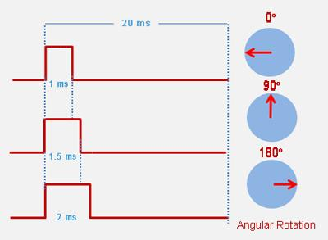
Position control using PWM:
The angle of rotation of servo motor is controlled by the duration of applied pulse to its Control PIN.
There is a minimum pulse, a maximum pulse and a repetition rate.
Servo motor can turn 90 degrees from either direction from its neutral position.

Slide 24
COMPONENTS(…)
ESP32 CAM board
ESP32 CAM has integrated with WiFi, Bluetooth and can be used with OV2640 or OV7670 cameras.
Has high revolution ADCs, SPI,12C, and UART protocols for information communications. The module has a maximum clock frequency of 160MHz.
18 High-resolution analog to digital converters.
16 PWM channels to output pulse width modulated signals.

Slide 25
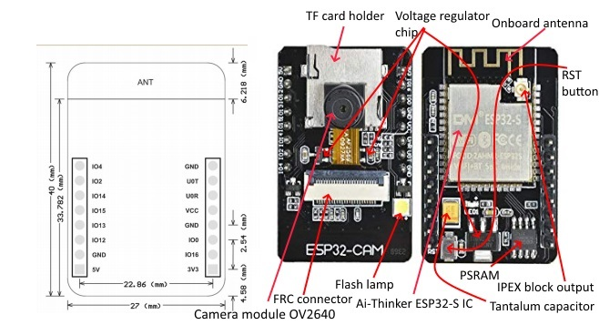
ESP32 CAM board
Specifications:
Operating Temperature is 5 Volts.
Processor 32-bit LX6
SRAM: 520 KB
PRAM: 4 MB
ESP32 cam board pinout

Slide 26
COMPONENTS(…)
ESP8266
ESP8266 is a very low cost & user-friendly WiFi module, which develops a simple TCP/IP connection and can easily be interfaced with microcontrollers via Serial Port.
It’s normally used in IOT cloud based embedded projects and is considered the most widely used WiFi module because of its low cost and small size.
There are numerous breakout boards available based on ESP8266 WiFi Module
ESP8266 Pinout consists of 30 pins

Slide 27
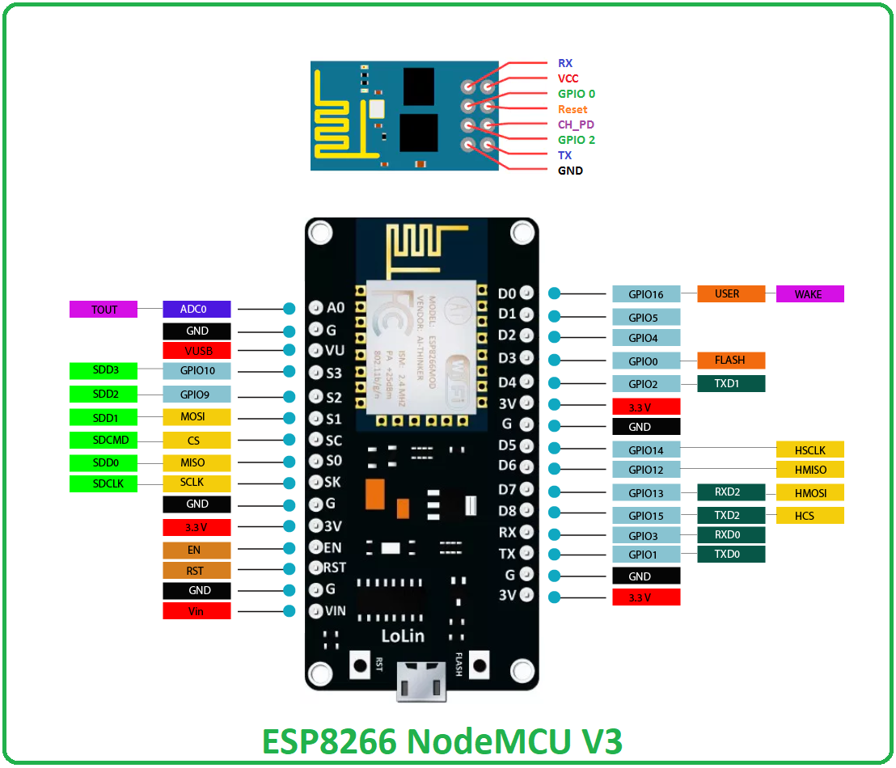
COMPONENTS(…)
ESP8266 (…)
Specifications:
Operating Voltage: 3.3V
Flash Memory: 4 MB
Clock Speed: 80 MHz
Input Voltage: 7-12V
ESP8266 Pinout

Slide 28
MOTOR DESIGN
Weight Calculation
Battery=309 g
Motor+Wheels=150∗4=600g
ESP32=140g
Camera=40g
Motor Controller=25g
Light sensor=1.1g
Temperature and humidity sensor=2.4g
Soil moisture sensor=20g
Servo motors=120g
Circuit board=40g
Base board=200g
Total weight=1.6kg

Slide 29
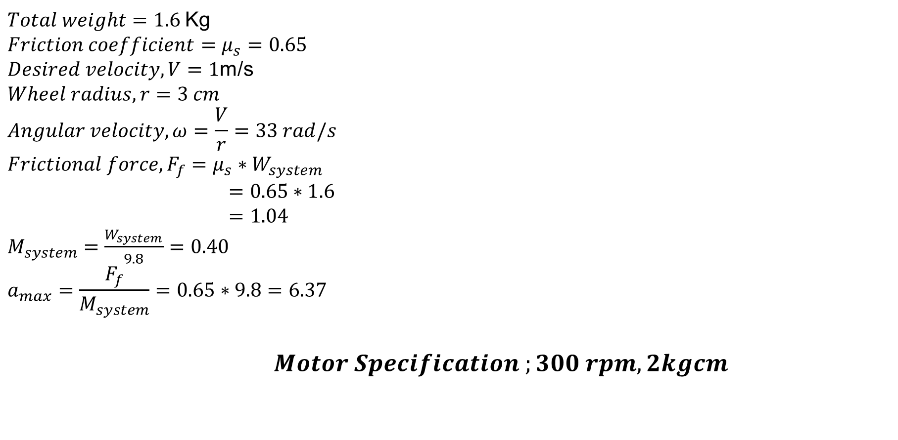
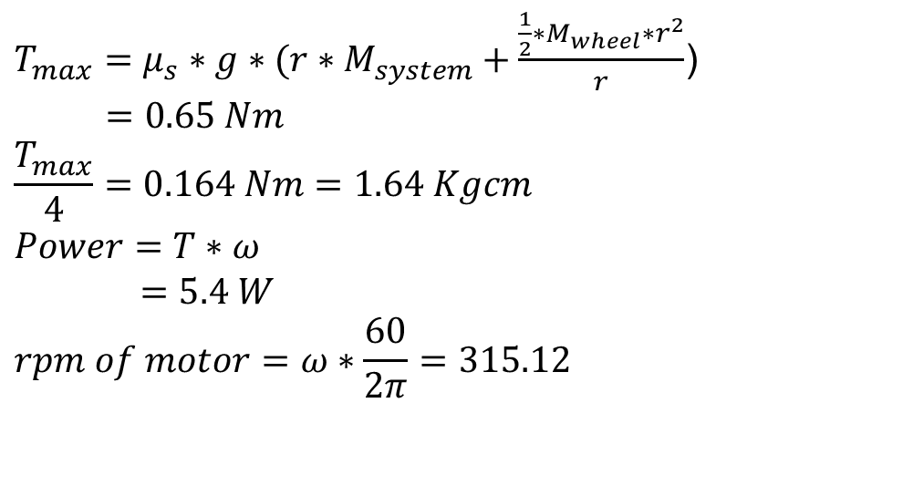
MOTOR DESIGN(…)

Slide 30
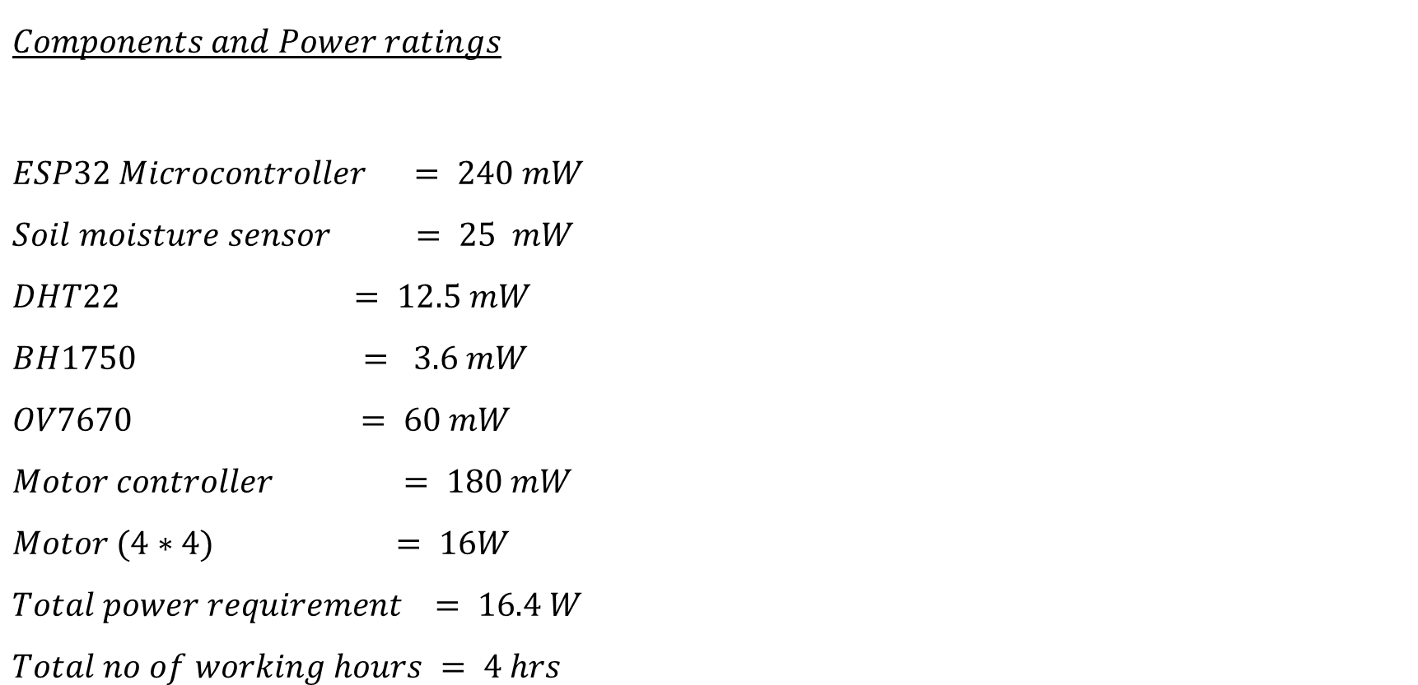
BATTERY DESIGN

Slide 31
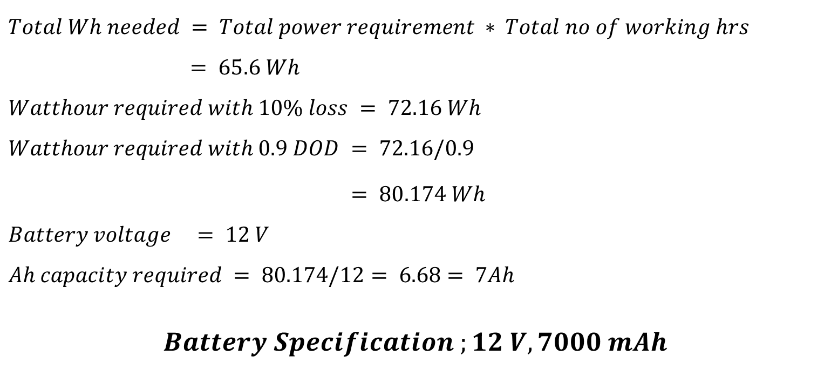
BATTERY DESIGN (….)

Slide 32
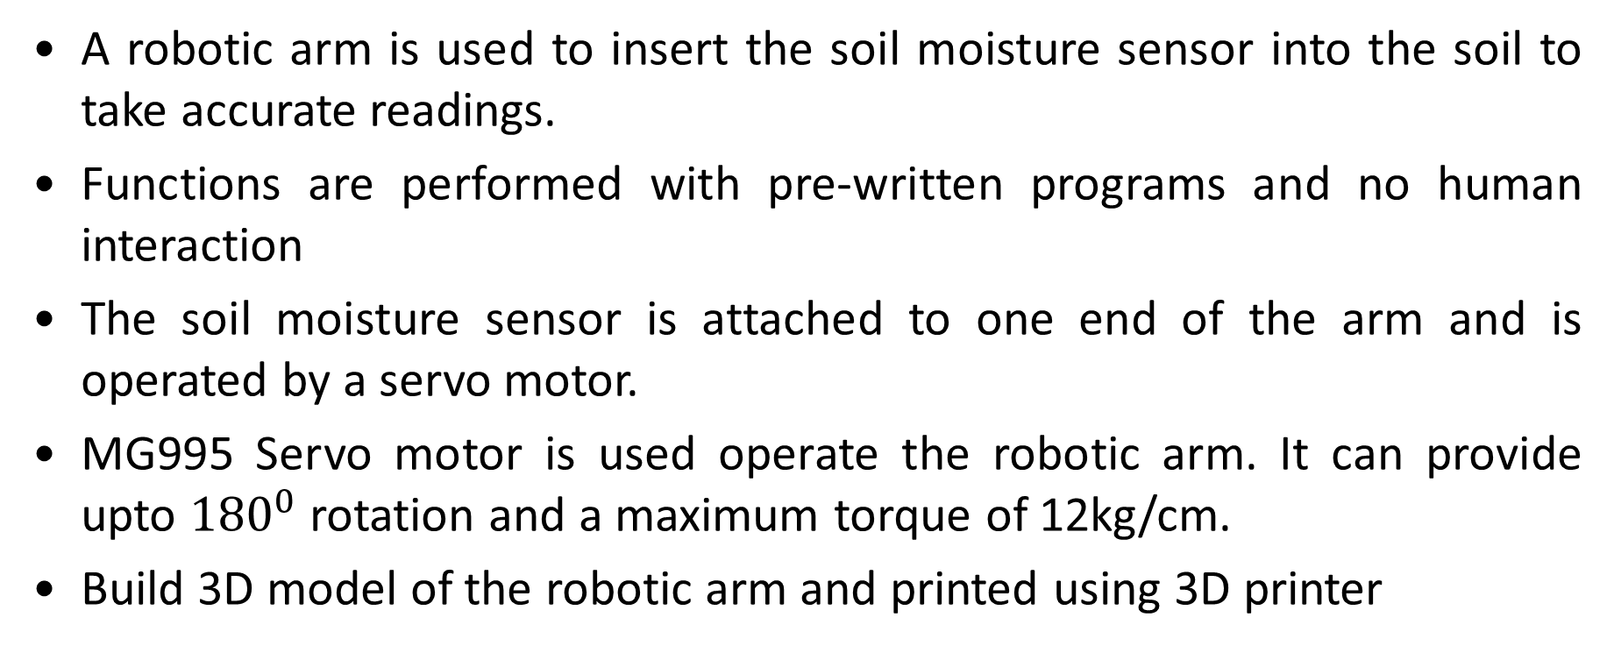
ROBOTIC ARM

Slide 33
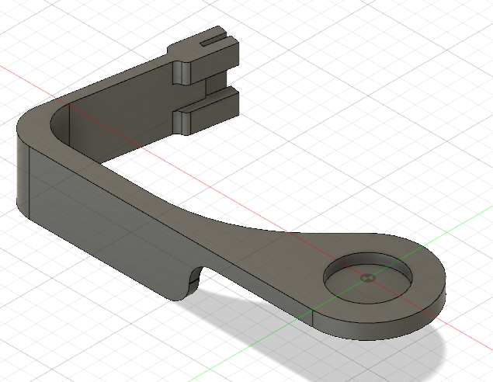
3D MODEL OF THE ROBOTIC ARM

Slide 34
CASE STUDY
Selected two plants with different growing conditions : Coriander and Red Spinach
PARAMETER | CORIANDER | RED SPINACH
Temperature Range | 17-25 ̊ C | 25-30 ̊ C
Moisture level | 45-55% | 30-50%
Sunlight | 6-8 hrs, 25000-40000 lux | 7-8 hrs, 8000-28000 lux
pH | 6.2 to 6.8 | 7.5 to 9.5
Season | October to november | Throughout the year

Slide 35
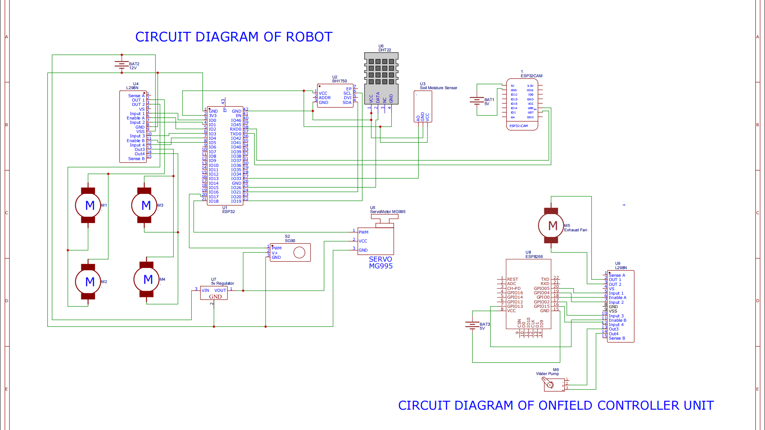
CIRCUIT DIAGRAM

Slide 36
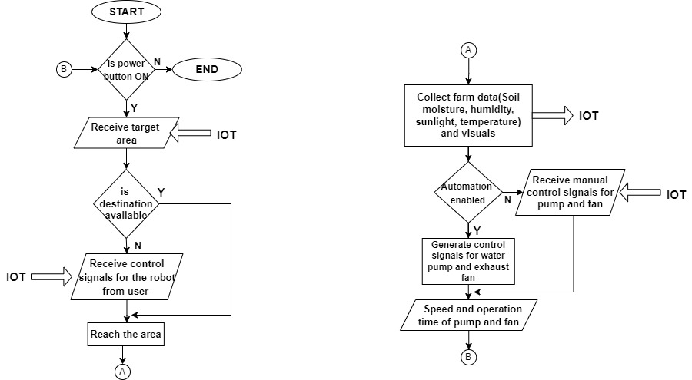
FLOWCHART OF MONITORING AND CONTROLLING PROCESS

Slide 37
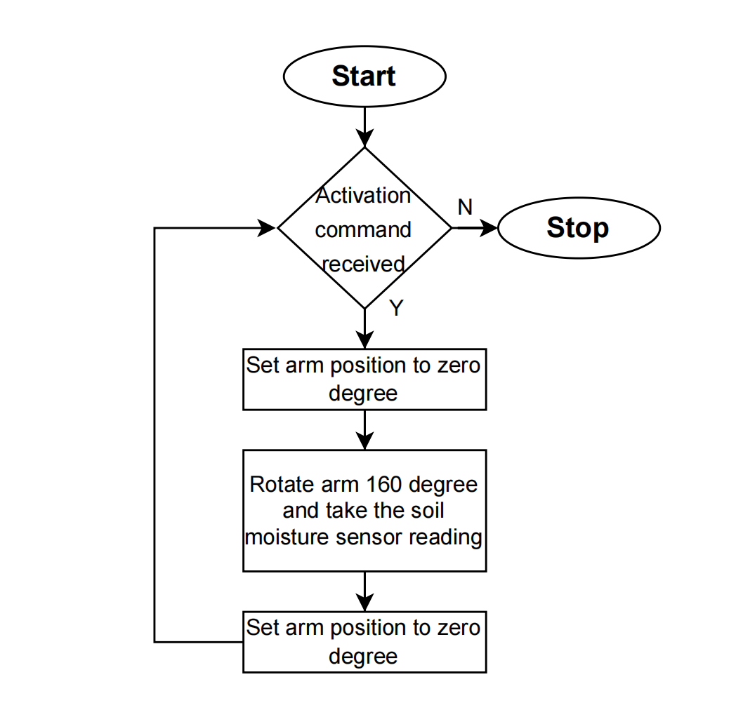
FLOWCHART ROBOTIC ARM

Slide 38
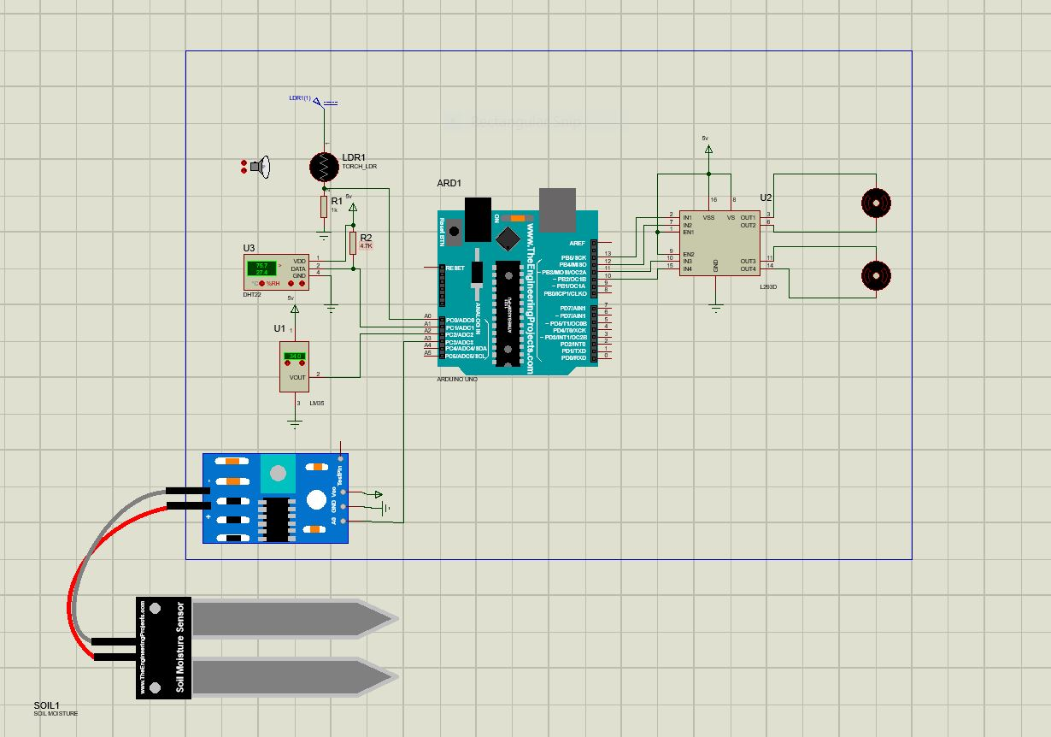
SIMULATION(sensors & motors)

Slide 39
IRRIGATION CONTROL
The irrigation level is controlled by varying the operation speed of the water pump.
The operation speed is selected either manually by the user or automatically based on the moisture percent in the soil.
Controlled irrigation based on soil moisture can definitely save both electricity and water. In addition it also provides optimum growing conditions for the crops thus the yield also gets enhanced.

Slide 40
Selection of Speed and Operation Time of Water Pump
SOIL MOISTURE VALUE | SPEED (0-5 levels) | OPERATING TIME
<10% | 5 | 15 min
10-15% | 4 | 10 min
15-30% | 3 | 7 min
30-40% | 2 | 5min
40-60% | 1 | 3 min
>60% | 0 | -

Slide 41
EXHAUST CONTROL
Humidity and temperature inside the greenhouse also affects the crop growth as well as its overall yield. Therefore these values need to be maintained within optimum ranges for each crop.
The humidity and temperature levels in the greenhouse is also controlled by varying the speed of exhaust fan.
Based on the temperature and humidity values sensed by the robot the operation of exhaust fan can be controlled either manually or automatically.

Slide 42
Selection of Speed and Operation Time of Exhaust Fan
HUMIDITY & TEMP VALUE | SPEED (0-5 levels) | OPERATING TIME
>90% | 5 | 10 min
90-85% | 4 | 8 min
85-80% | 3 | 6 min
80-78% | 2 | 4 min
78-70% | 1 | 2 min
<70% | 0 | -
temp > 34 ̊ C | 5 | 10 min

Slide 43
PATH PLANNING
Path planning is also implemented which enables the robot to reach the target area on it’s own based on the destination provided by the user.
The robot uses distance, speed and directions to formulate the path to reach the specified location from it’s starting location.
It uses the same process to return to it’s initial starting position after performing monitoring in the area selected by the user.
The aim of path planning is to make the robot more smart and efficient. It also makes the robot more user friendly .

Slide 44
RESULT ANALYSIS
To test and verify the IoT based smart agriculture robotic system, we collected data under different conditions and the following results were obtained
Trial 1
Temperature(°C) | 29 ̊ C | 28 ̊ C | 28 ̊ C | 28 ̊ C
Humidity(in %) | 78% | 81% | 81% | 79%
Soil Moisture (in %) | 13% | 13% | 65% | 43%
Trial 2
Temperature(°C) | 27 ̊ C | 27 ̊ C | 30 ̊ C | 30 ̊ C
Humidity(in %) | 90% | 77% | 76% | 76%
Soil Moisture (in %) | 0% | 0% | 42% | 99%

Slide 45
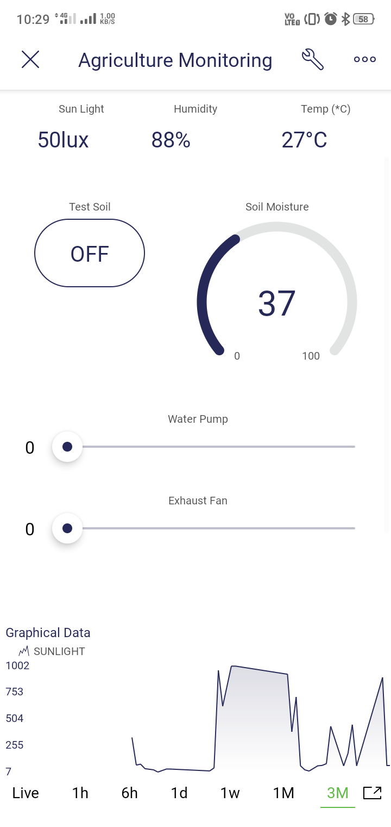
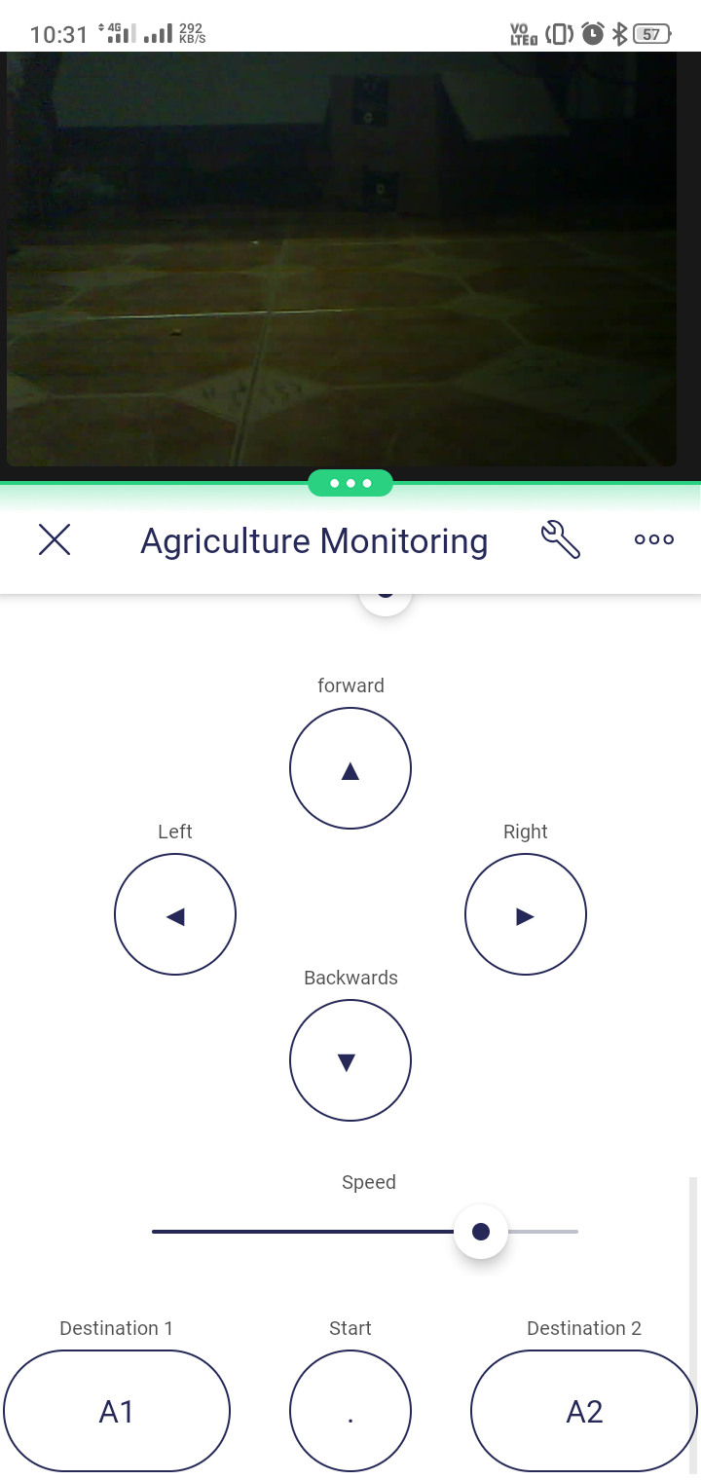
BLYNK
INTERFACE

Slide 46
REFERENCES
[1] Md Shadman Tajwar Haque;Khaza Abdur Rouf;Zobair Ahmed Khan;Al Emran;Md. Saniat Rahman Zishan, “ Design and Implementation of an IoT based Automated Agricultural Monitoring and Control System,” 2019 International Conference on Robotics,Electrical and Signal Processing Techniques, vol. 21, no. 3, pp. 567– 577, May 2019.
[2] Liu Dan;Cao Xin;Huang Chongwei;Ji Liangliang, “Intelligent Agriculture Greenhouse Environment Monitoring System Based on IOT Technology, ” 2015 International Conference on Intelligent Transportation, Big Data and Smart City, vol. 54, no. 3, pp. 763–770, May 2015. [3] Chen, Qi, Gui, Gu, Ma, Zeng, et al., "A model-based real-time decision support system for irrigation scheduling to improve water productivity, " Agronomy, vol. 9, no. 11, pp. 686, Oct. 2019, vol. 55, no. 6, pp. 2258–2267.
[4] Mehedi Hasan;Kamrul Nazir Walli Uddin;Tasnuva Tasneem, “ Smart Agriculture Robotic System Based on Internet of Things to Boost Crop Production, ” 2021 2nd International Conference on Robotics, Electrical and Signal Processing Techniques (ICREST), Sep. 2021, pp. 1–6.

Slide 47
[5] Ji-chun Zhao;Jun-feng Zhang;Yu Feng ;Jian-xin Guo ” The study and application of the IOT technology in agriculture, ” 2010 3rd International Conference on Computer Science and Information Technology, vol. 53, no. 1, pp. 199–205, Jan. 2010.
[6] IOT Based Agriculture Monitoring and Controlling System A. Lakshmi;Y. Ravi Kumar;N. Sai Krishna;G. Manisha 2021 6th International Conference on Communication and Electronics Systems (ICCES), vol. 40, no. 1, pp. 96–104, Feb. 2021.
[7] Md AshifuddinMondal ;Zeenat Rehena “ IoT Based Intelligent Agriculture Field Monitoring System, ” 2018 8th International Conference on Cloud Computing, Data Science & Engineering, June 2018, pp. 1369–1374

Slide 48
[8] N. Romano, "Soil moisture at local scale: Measurements and simulations," J. Hydrol., vol. 516, pp. 6-20, Aug. 2014.
[9] Yash Bhojwani;Rishab Singh;Rachana Reddy; Boominthan Perumal “Crop Selection and IoT Based Monitoring System for Precision Agriculture, ” 2020 International Conference on Emerging Trends in Information Technology and Engineering (ic- ETITE).
[10] Nisar Ahmad;Ali Hussain;Ihsan Ullah;Bizzat Hussain Zaidi,” IOT based Wireless Sensor Network for Precision Agriculture, ” 2019 7th International Electrical Engineering Congress, Sep. 2019, pp. 477–482.
[11] S. R. Prathibha;Anupama Hongal;M. P. Jyothi, “ IOT Based Monitoring System in Smart Agriculture, ” 2017 International Conference on Recent Advances in Electronics and Communication Technology, Sep. 2017, p. 6.
[12] Tianchen Qiu;Hang Xiao;Pei Zhou, “ Framework and case studies of intelligence monitoring platform in facility agriculture ecosystem, ” 2013 Second International Conference on Agro-Geoinformatics, Apr. 2013, pp. 1685–1690.

Slide 49
THANK YOU

